Slide 1
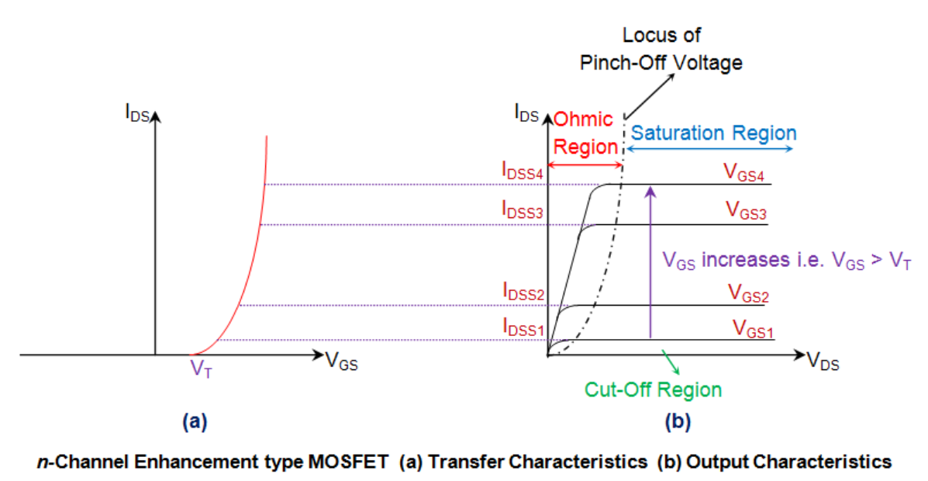
MOSFET Input-Output Characteristics

Slide 2
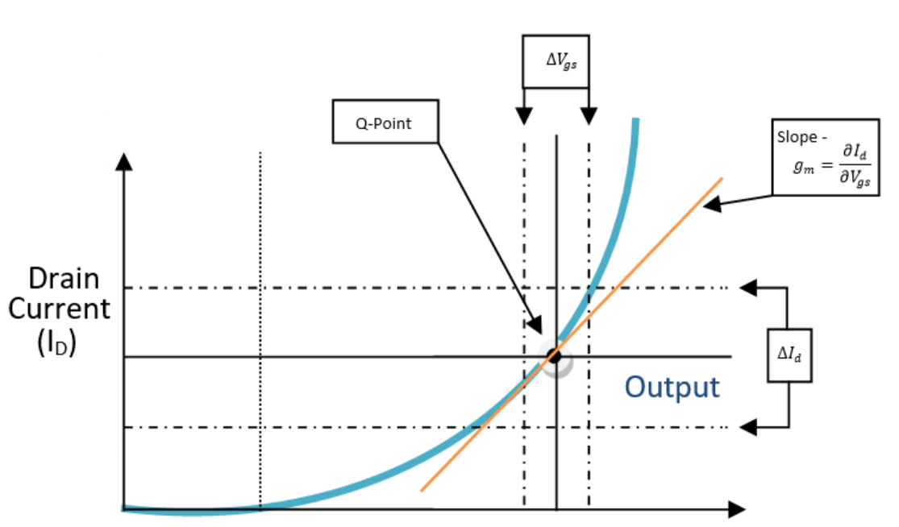
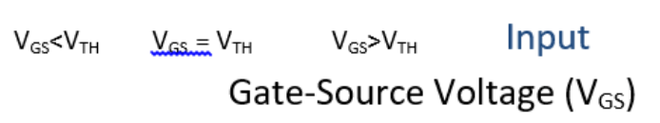
MOSFET Input-Output Characteristics

Slide 3
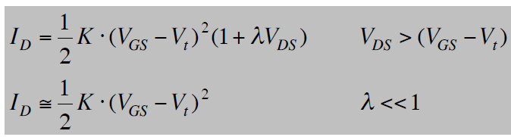
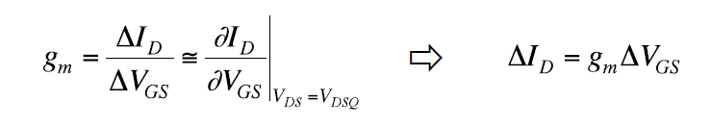
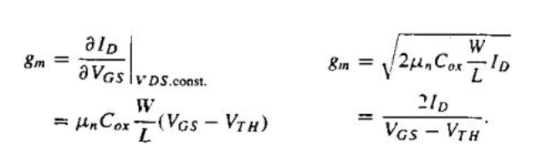
Geçiş-iletkenliği (Transconductance)
Current relation of the transistor working in the saturation region::

Slide 4
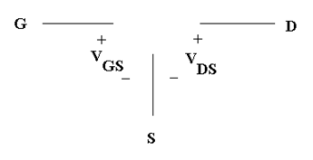
Piecewise Model Cut-off Region
V_{GS} < V_{TN}
V_{TN} is positive
I_{D} = 0 mA

Slide 5
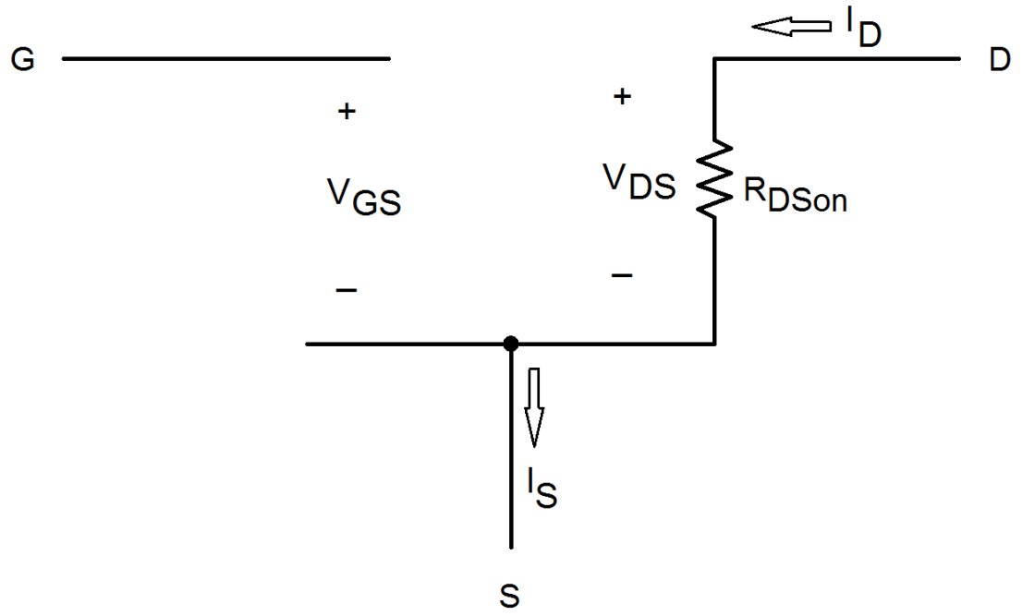
Piecewise Model Nonsaturation/Triode Region
V_{GS} > V_{TN}
V_{DS} < V_{GS} – V_{TN}
0 mA ≤ I_{D}
V_{TN} is positive

Slide 6
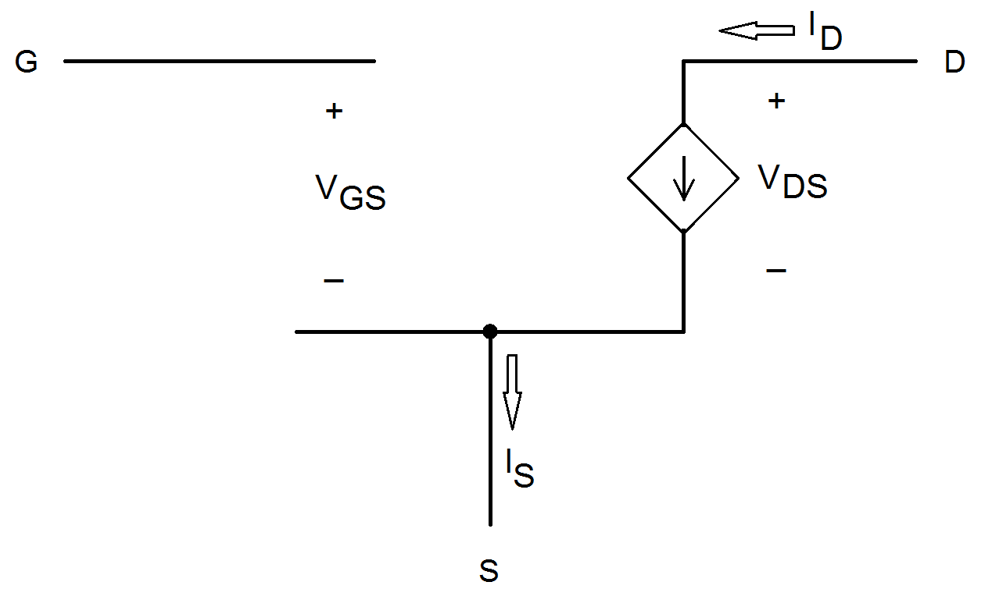
Piecewise Model Saturation/Pinch-off Region
V_{GS} > V_{TN}
V_{DS} > V_{GS} – V_{TN}
0 mA ≤ I_{D}
V_{TN} is positive

Slide 7
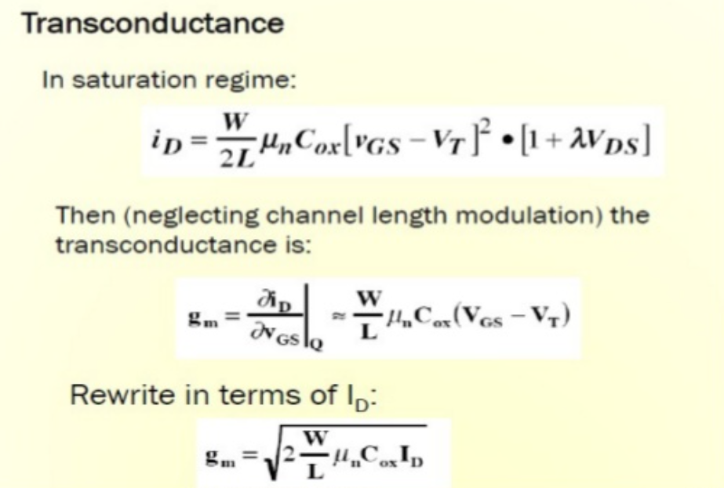

Slide 8
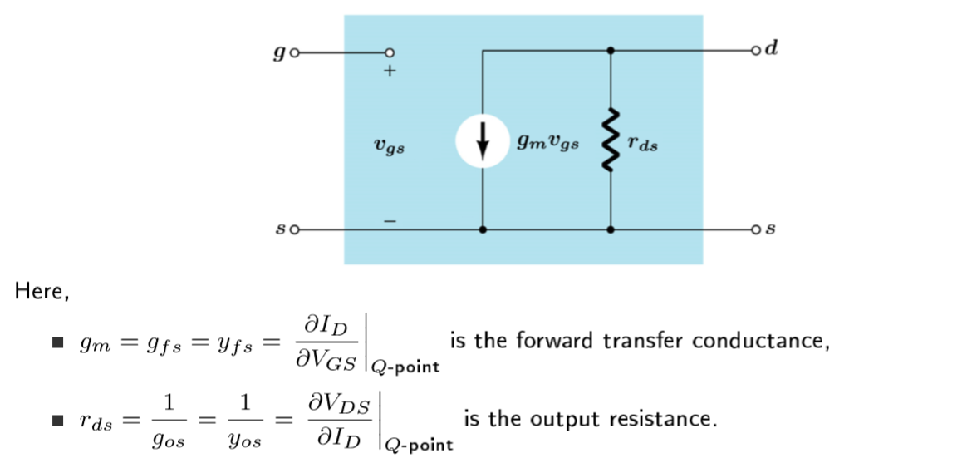
MOSFET Small-Signal Model

Slide 9
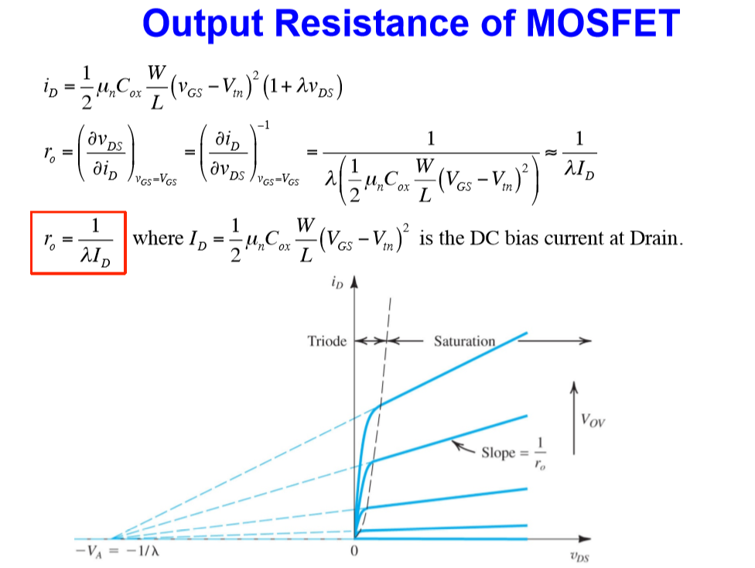

Slide 10
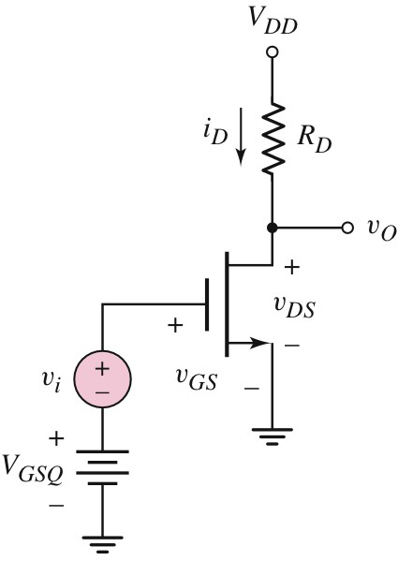
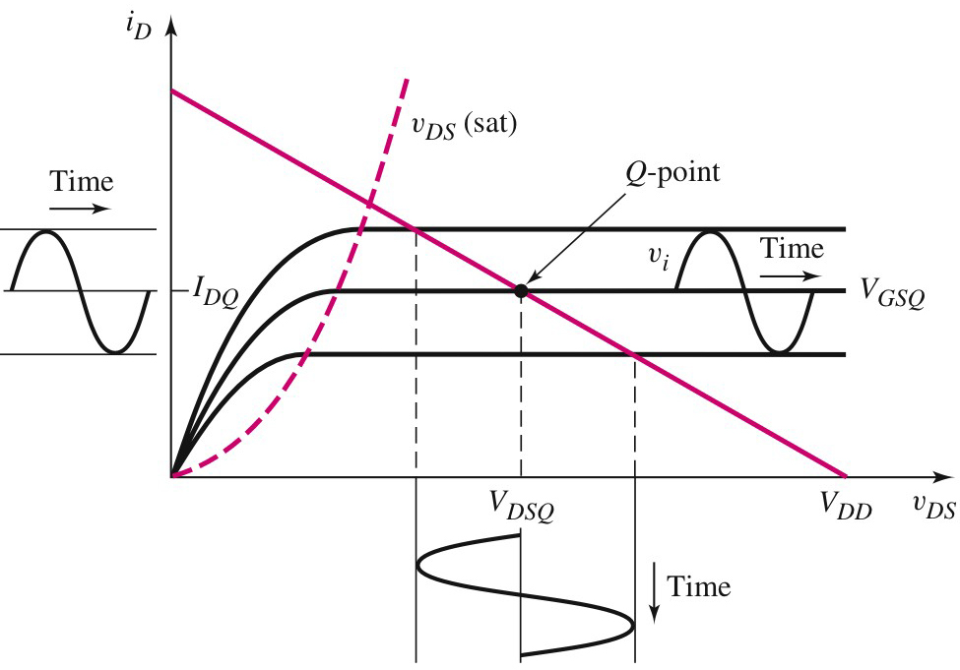
MOSFET
Basic FET Amplifiers
The MOSFET Amplifier
The Q-point is on dc load line and Q-point are functions of v_{GS}, V_{DD} and R_{D} and the transistor parameters.

Slide 11
MOSFET
Basic FET Amplifiers
The MOSFET Amplifier
The figure shows a basic MOSFET amplifier where the dc source V_{GSQ} is used to provide the bias voltage between gate and source.
The ac voltage source v_{i} which represents the signal source is connected in series with the bias voltage V_{GSQ}.

Slide 12
MOSFET
Basic FET Amplifiers
The MOSFET Amplifier
The figure shows the corresponding characteristic, load line and Q-point for the amplifier.

Slide 13
MOSFET
Basic FET Amplifiers
The MOSFET Amplifier
The sinusoidal input voltage (v_{i}) causes variations in the gate-to-source voltage (v_{GS}), drain current (i_{D}) and drain-to-source voltage (v_{DS}).
Sinusoidal input voltage (v_{i})
Sinusoidal variation in the drain current (i_{D})
Sinusoidal variation in the drain-to-source voltage (v_{DS})

Slide 14
MOSFET
Basic FET Amplifiers
The MOSFET Amplifier
The total v_{GS} is the sum of V_{GSQ} and v_{i} i.e;
As v_{i} increases, the instantaneous value of v_{GS} increases, and the bias point moves up on the load line.

Slide 15
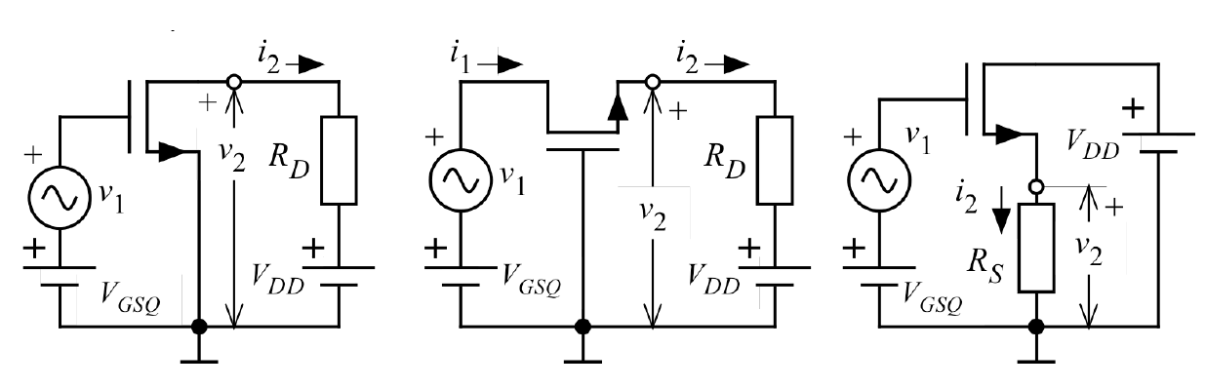
MOS Amplifiers Circuits
Common Source Circuit
Common Gate Circuit
Common Drain Circuit

Slide 16
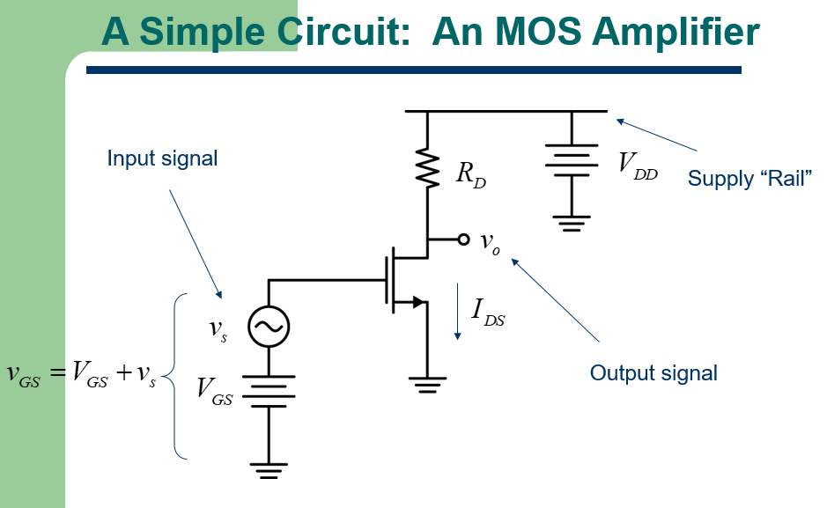

Slide 17
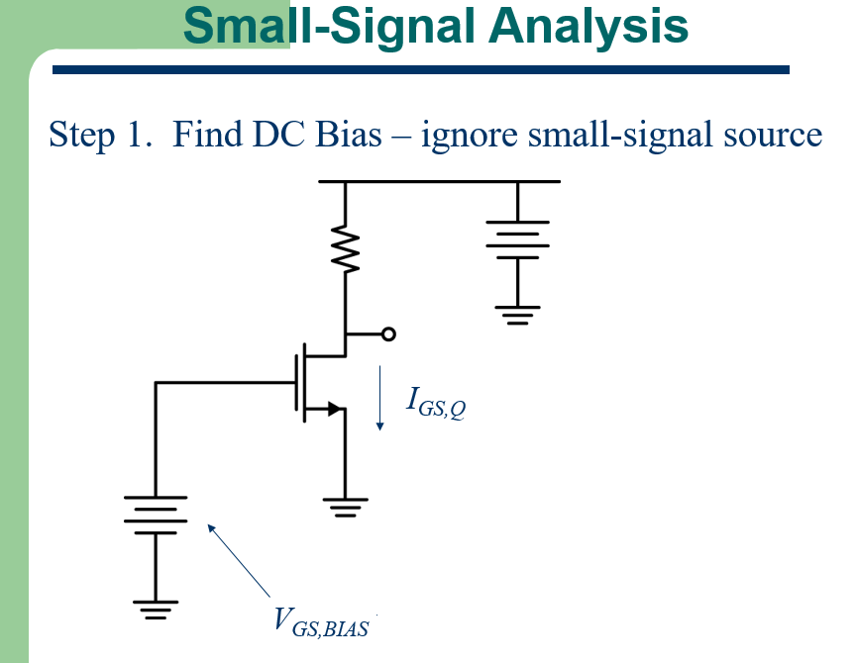

Slide 18
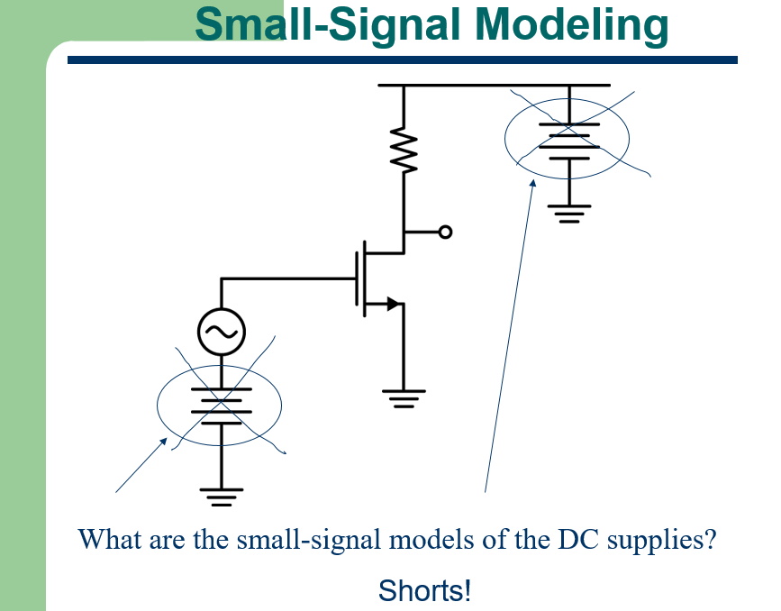

Slide 19
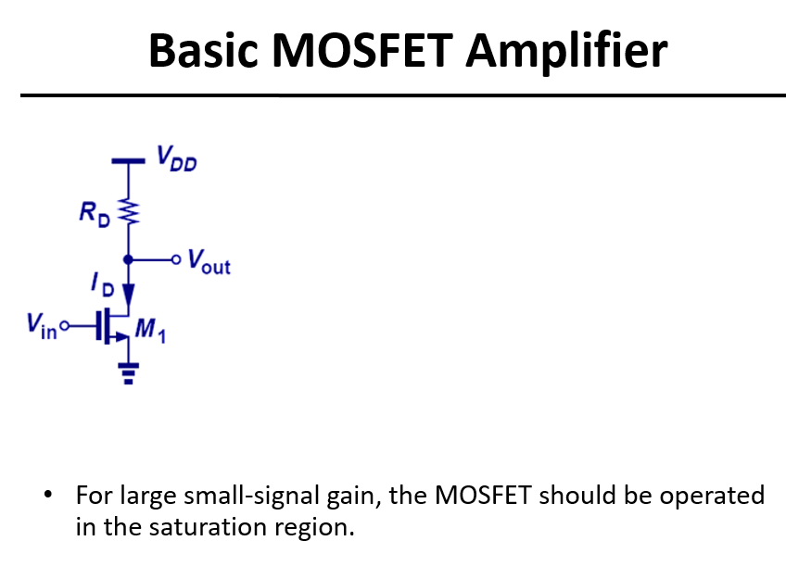

Slide 20
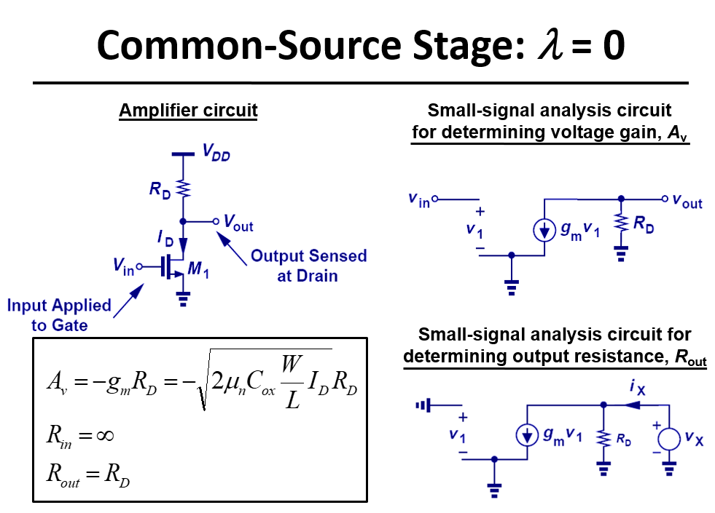

Slide 21
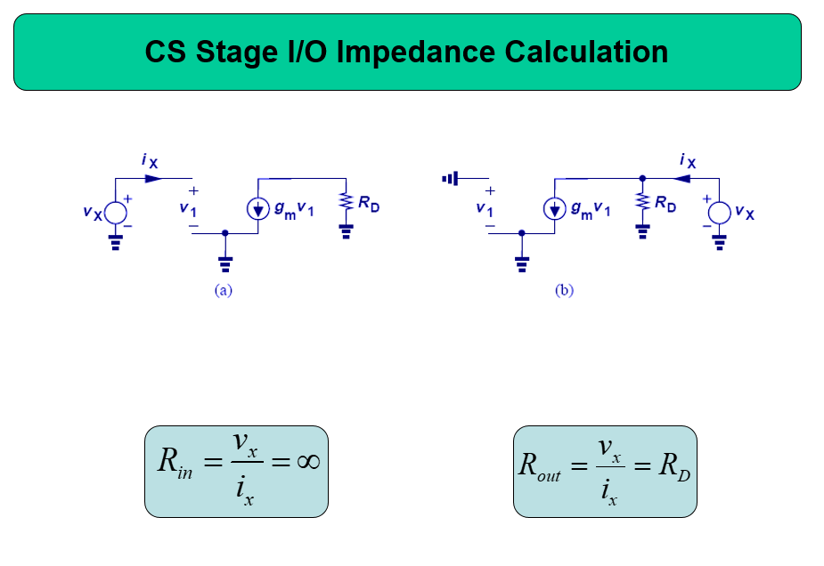

Slide 22
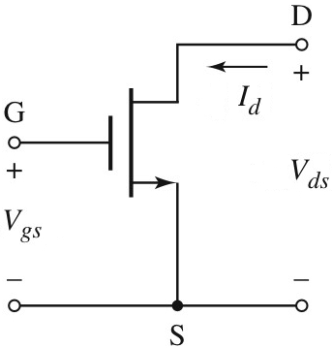
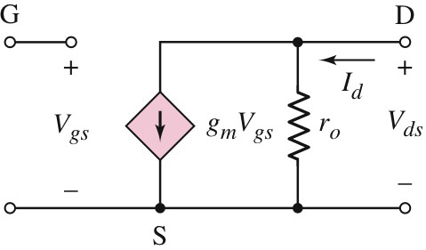
The small-signal equivalent circuit with r_{o} taken into account.

Slide 23
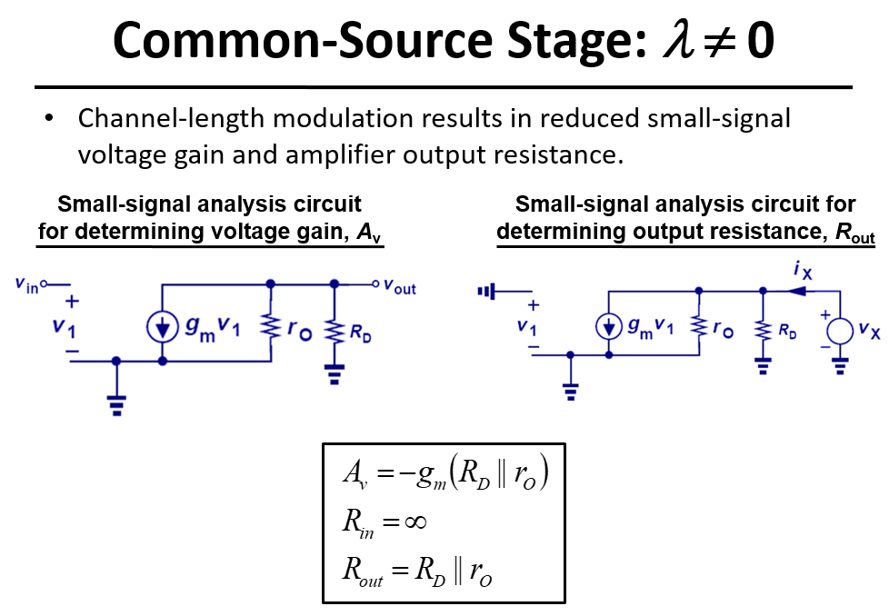

Slide 24
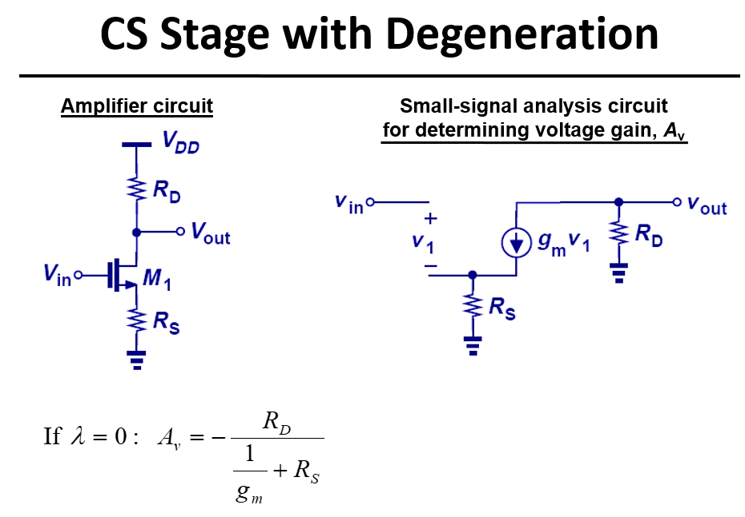

Slide 25
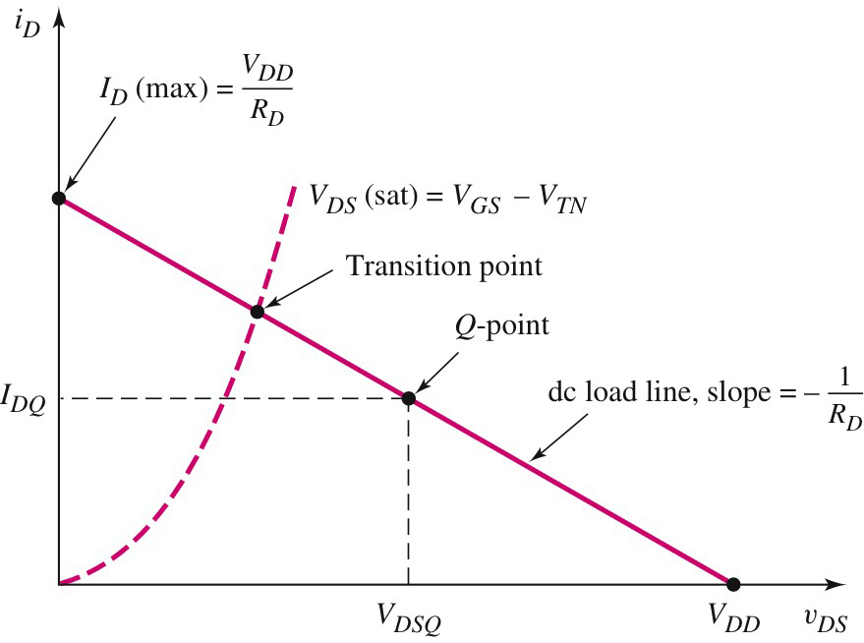
Common-source
Boundary between saturation and triode region
For maximum symmetrical swing, the Q-point must be near the middle of the saturation region
Triode region
Saturation region

Slide 26
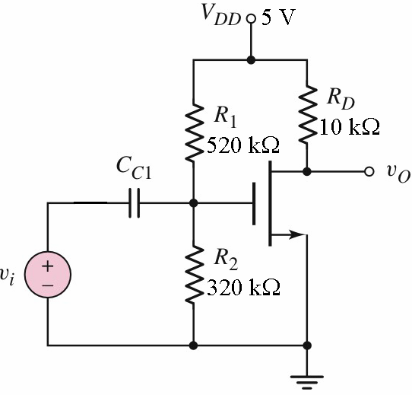
Common-source
Example 1
The transistor in the figure has the following parameters;
Find the following;
(a) g_{m} and r_{o};
(b) A_{v};
(c) R_{i} and R_{o}.

Slide 27
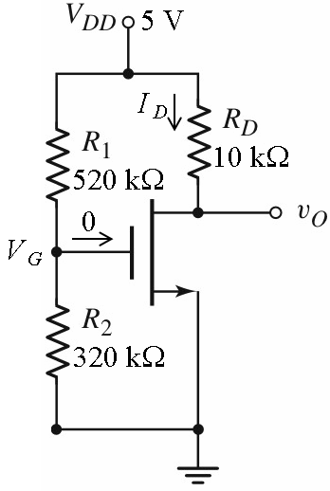
Common-source
Example 1 – Solution
(a)
The circuit under dc condition

Slide 28
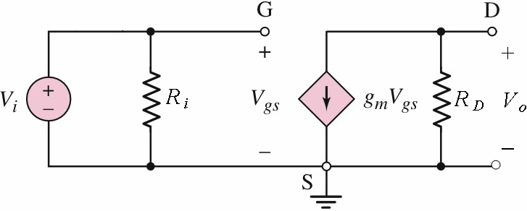
Common-source
Example 1 – Solution
(b)

Slide 29
MOSFET
Basic Amplifier Configurations
Common-source
Example 1 – Solution (cont’d)
(c)

Slide 30
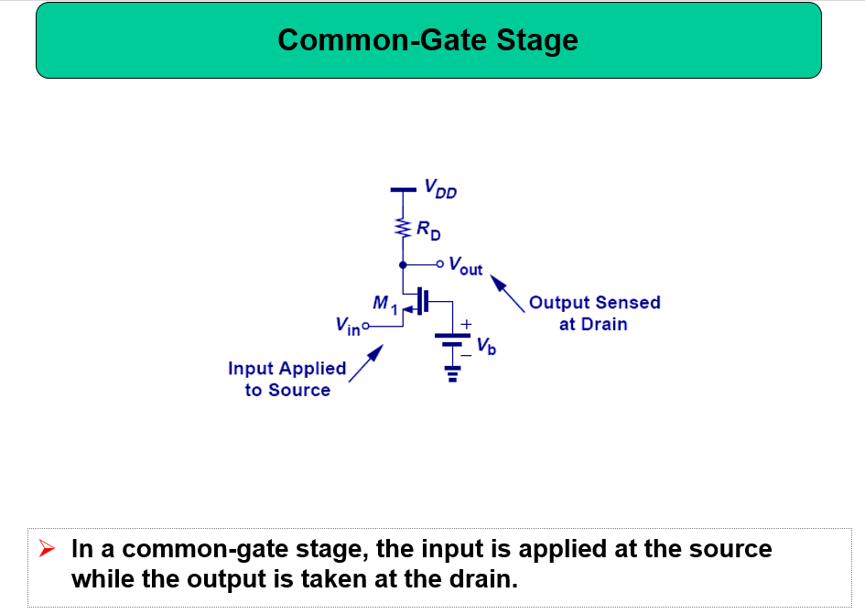

Slide 31
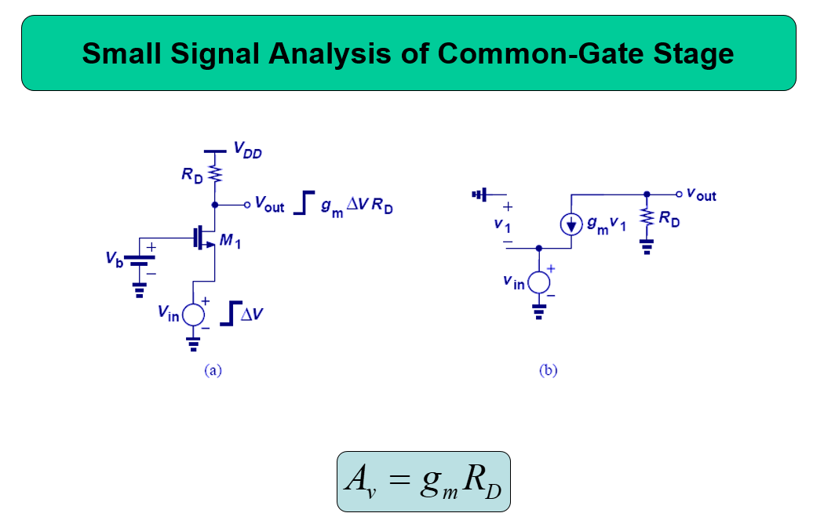

Slide 32
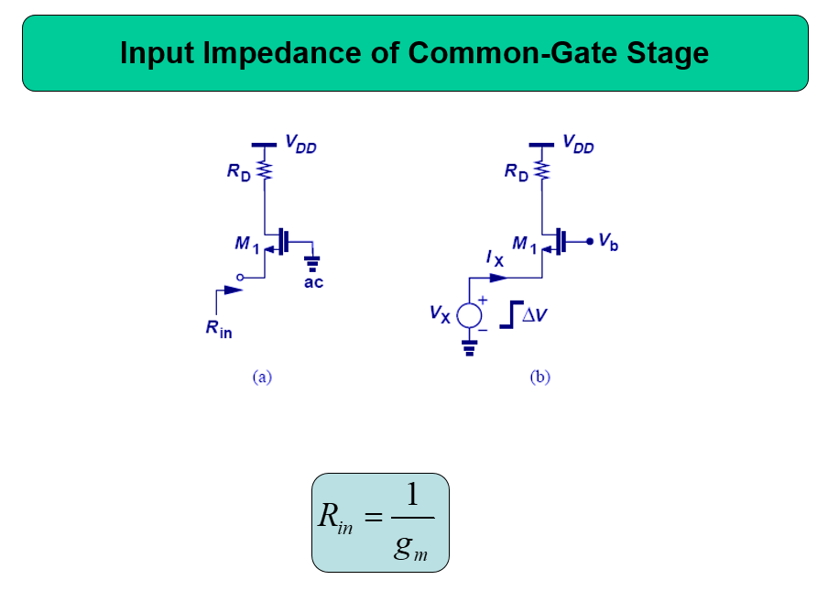

Slide 33
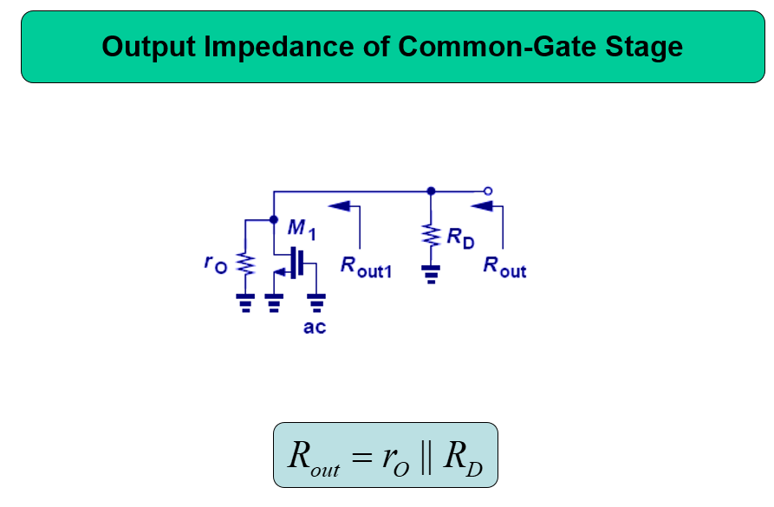

Slide 34
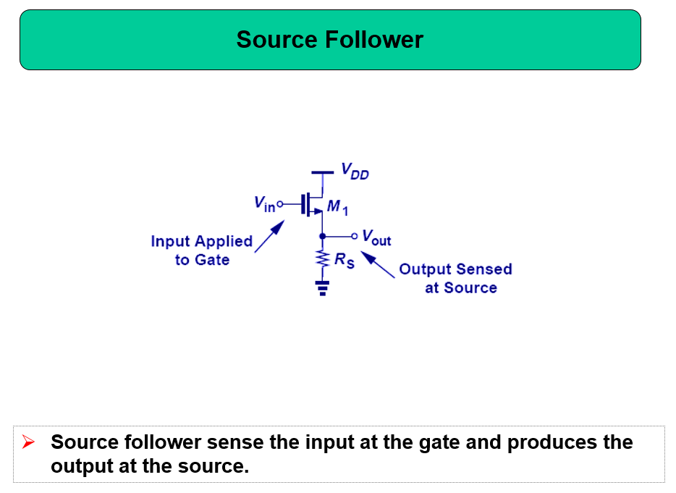

Slide 35
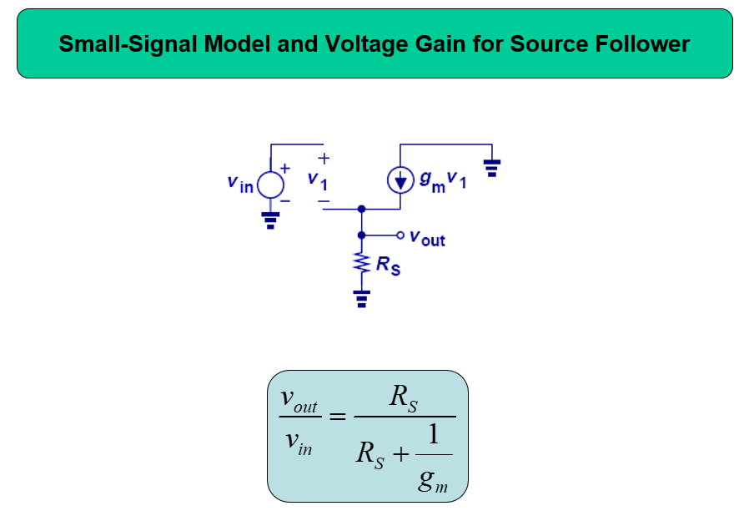

Slide 36
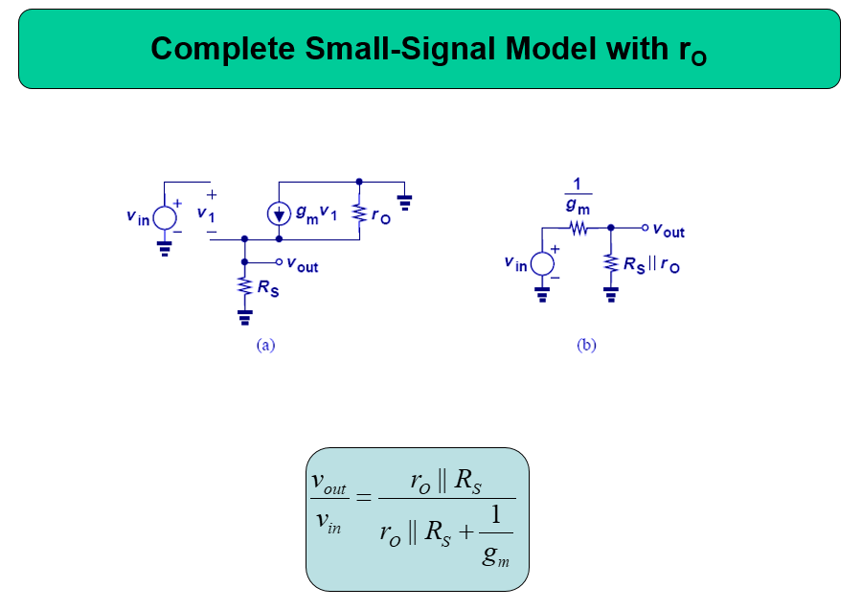

Slide 37

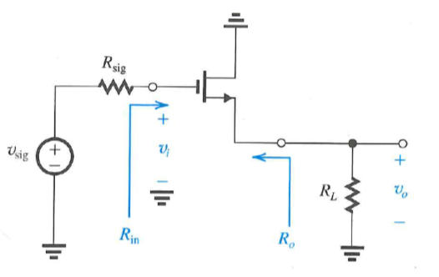
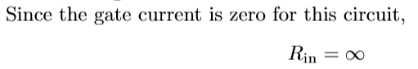
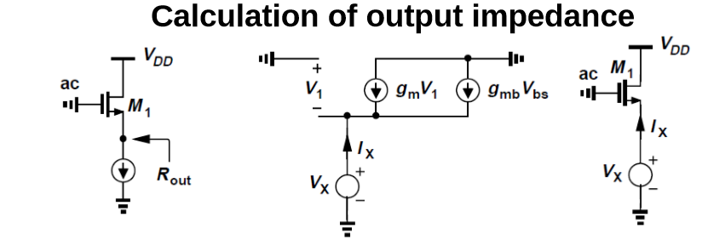
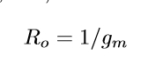
Input/Output Resistance

Slide 38
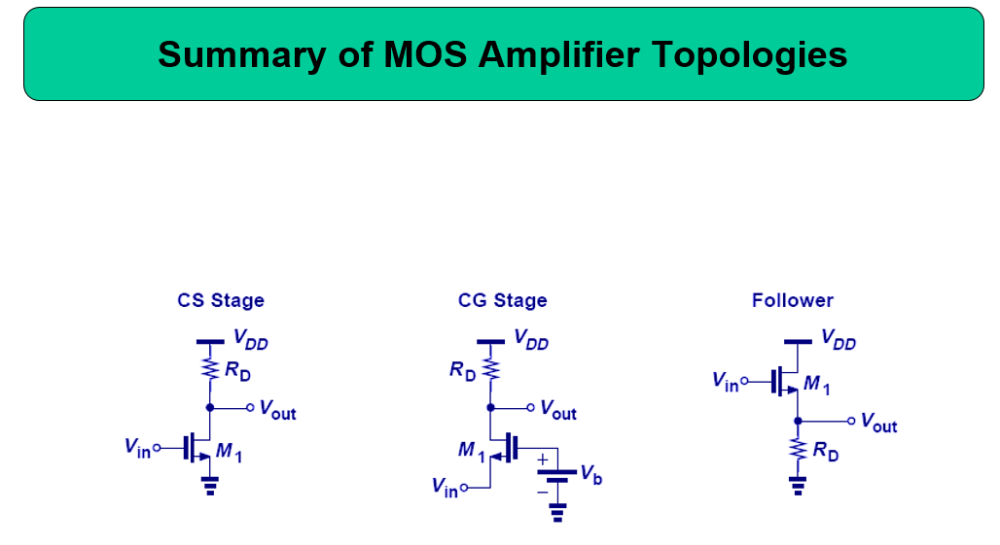

Slide 39
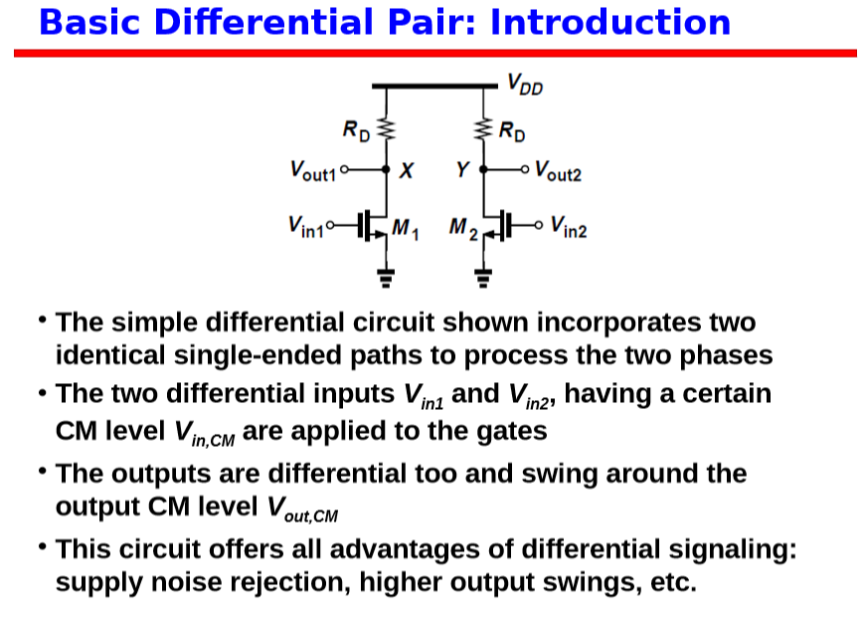

Slide 40

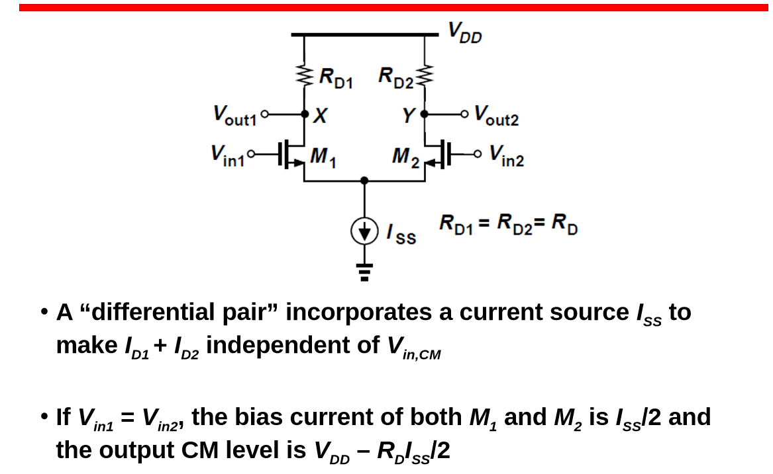

Slide 41
COMMON MODE OPERATION
In common mode operation, the voltage difference between the two drains is zero.
As long as the transistors Q1 and Q2 remain in saturation, the current I will be divided equally between them, so that the voltage values at the ends of the drain will not change.
Thus, the differential amplifier will not output if the inputs are common signals.

Slide 42
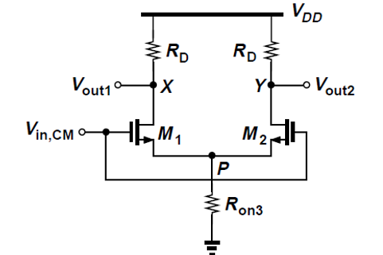
COMMON MODE OPERATION : DC ANALYSE
• Set Vin1 = Vin2 = Vin,CM and vary Vin,CM from 0 to VDD
• Due to symmetry, Vout1 = Vout2
• With ID1 = ID2 = 0, circuit is incapable of signal amplification; Vout1 = Vout2 = VDD, and VP = 0

Slide 43
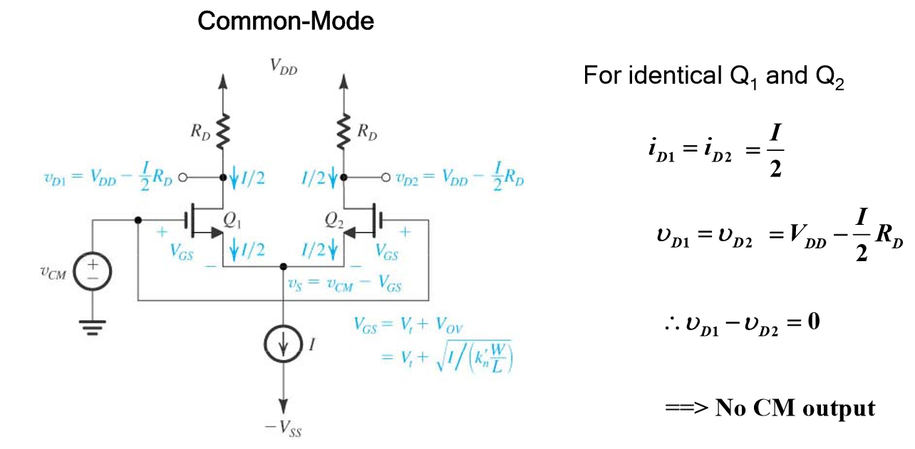
COMMON MODE OPERATION: DC ANALYSE

Slide 44
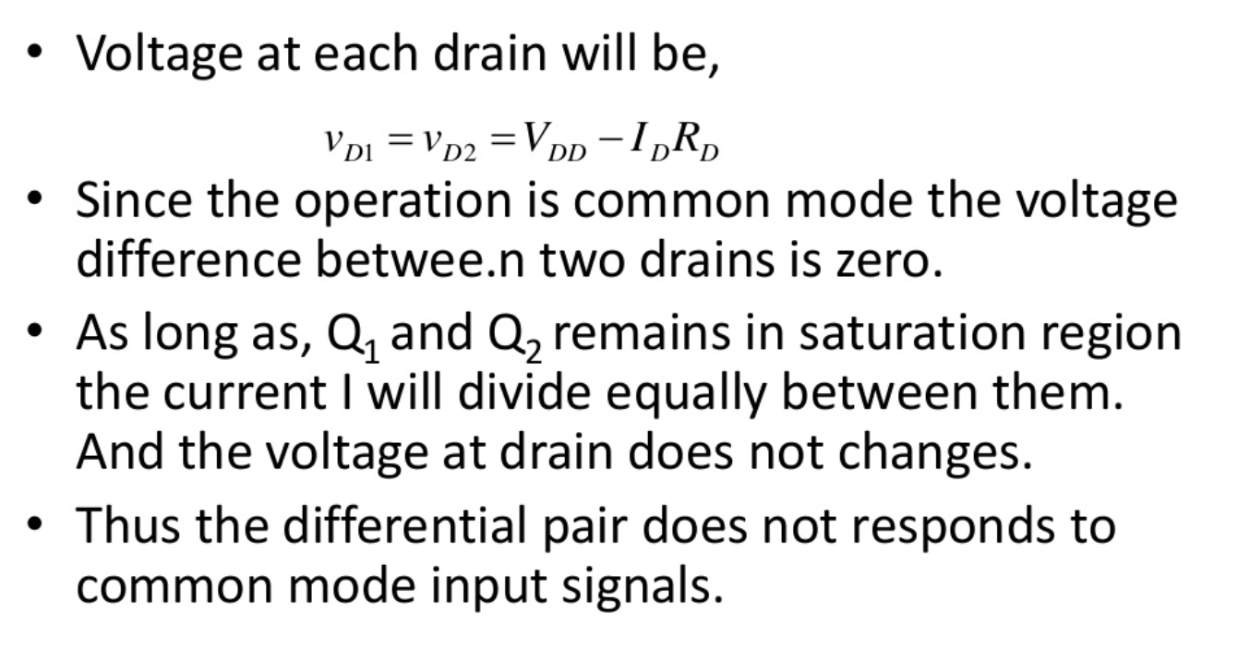
COMMON MODE OPERATION

Slide 45
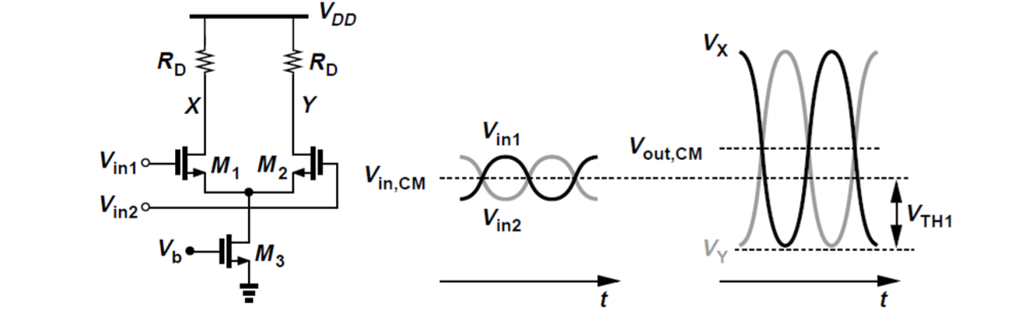
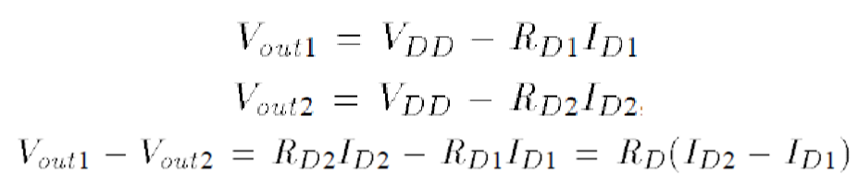
DIFFERENTIAL MODE OPERATION: DC ANALYSE

Slide 46
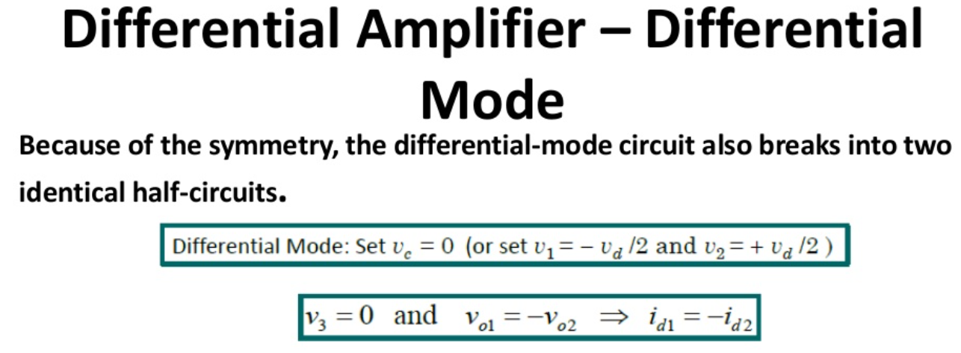
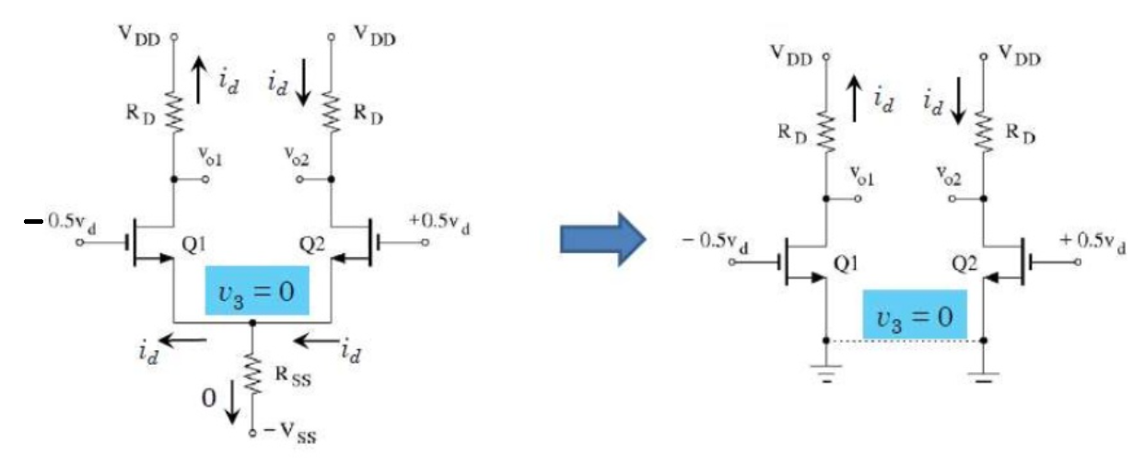

Slide 47

Differential Mode Operation: Small Signal Analysis

Slide 48






Small Signal operation of Differential Gain

Slide 49


Small Signal Operation of Common Mode

Slide 50



Small Signal Operation of Common Mode

Slide 51





Slide 52
Common mode rejection ratio (CMRR)
CMRR is a measure of how well the differential amplifier suppresses the input voltage in common mode.

Slide 53

MOSFET CURRENT MIRROR
The concept of Current Mirror can be applied to MOS transistors in the same way.

Slide 54

MOSFET
The MOSFET Amplifier
Example 1
The MOSFET in the figure has the following parameters;
The transistor is biased for I_{DQ} = 0.4 mA.
(a) Draw the ac equivalent circuit.
(b) Draw the small-signal equivalent circuit.
(c) Determine the small-signal voltage gain A_{v}.

Slide 55


MOSFET
Basic FET Amplifiers
The MOSFET Amplifier
Example 1 – Solution
(a)
For the ac equivalent circuit, all dc voltage sources are set to zero;
(b)
Since λ = 0, the output resistance r_{o} is omitted in the small-signal equivalent circuit;

Slide 56



MOSFET
Basic FET Amplifiers
The MOSFET Amplifier
Example 1 – Solution (cont’d)
(c)

Slide 57
MOSFET
Basic FET Amplifiers
The MOSFET Amplifier
Example 1 – Solution (cont’d)
At the output terminal;
At the input terminal;
Substituting for V_{gs};
The small-signal voltage gain is;

